Slide 1

Exploring network effects during bank failures in Argentina
Emiliano A. Carlevaro
University of Western Australia
Jornadas SADAF octubre 2021
Research supported through an Australian Government RTP Scholarship and the University of Western Australia Dean's Excellence PhD Scholarship.
Notes:
Bank mutual relations comprise multiple areas: syndicated loans market (many banks lending the same borrower), overnight interbank market, derivative positions (or swaps), wholesale deposit market. We only consider loans reported in the credit registry.
Interbank market data relies on trading data. In some cases the identities of the parties is unknown

Slide 2









Hipótesis sobre fallas bancarias
Estructura de capital
Diamond & Dybvig (1983)
Holmström & Tirole (1997)
Diamond & Rajan (2005)
Whalter (2016)
Diamond & Rajan (2001)
$$p_{i}^{∗}$$
$$p_{j}^{∗}$$
$$p_{k}^{∗}$$
Berger 1995, JMCB
Gonzales-Hermosillo (1999)
Dabos Sosa-Escudero (2004)
Arena (2005)
“Virtually all such studies find that low capital ratios raise the probability of bank failure.”
Berger & Roman (2020)
Notes:
El apalancamiento excesivo en relación al riesgo tomado en el active y/o el fondeo con deuda de corto plazo. En el caso argentino el descalce de moneda
Is the same?
Are more connected system more resilient? Depends
Diamond & Rajan: you don’t need a network to have contagious, amplyfing effects. All banks are connected through markets.
What it does not say: an arbitrary macro shocks does not generate contagious.

Slide 3
Hipótesis sobre fallas bancarias
Efectos de red
Allen & Gale 2000
Acemoglu, Carvalho, Ozdaglar Tahbaz-Salehi (2012)
Acemoglu, Ozdaglar Tahbaz-Salehi (2015)
$$p_{i}^{∗}$$
$$p_{j}^{∗}$$
$$p_{k}^{∗}$$
Virtually all such assume independent and thus isolated banks.
Estimación
Datos sobre la red
Notes:
Is the same?
Are more connected system more resilient? Depends
Diamond & Rajan: you don’t need a network to have contagious, amplyfing effects. All banks are connected through markets.
What it does not say: an arbitrary macro shocks does not generate contagious.

Slide 4





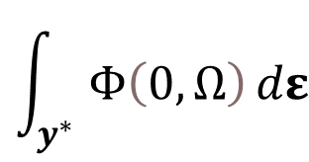













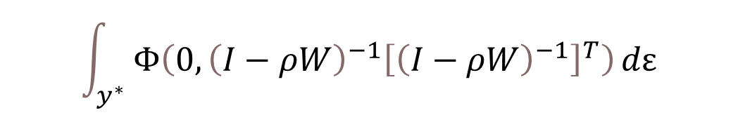








Estimation
$$y_{i,t}^{∗}=ρ\left(w_{j,t}y_{j,t}^{∗}+w_{h,t}y_{h,t}^{∗}\right)+x_{i,t}^{T}β+ε_{i,t}$$
$$ε_{i,t }∼𝒩\left(0,1\right)$$
Modelo probit
$$y_{i}^{∗}=x_{i}^{T} β + ε_{i}$$
$$ε_{i}∼𝒩\left(0,1\right)$$
$$y^{∗}=ρWy^{∗}+Xβ+ε$$
$$y_{i}=x_{i}^{T} β+u_{i}$$
i i d
$$y^{∗}=ρWy^{∗}+Xβ+ε$$
$$y_{t}^{∗}={\left(I−ρW\right)}^{−1} Xβ +{\left(I−ρW\right)}^{−1}ε$$
$$p_{i}$$
$$y_{i}=$$
$$1$$
with probability
$$Φ\left[x_{i,t}^{T} β \right]$$
$${1−p}_{i}$$
$$x_{i,t}^{T}β$$
$$0$$
with probability
$$ν$$
$$∼𝒩$$
Función de verosimilitud
$$(0,$$
$$?)$$
$${\left(I−ρW\right)}^{−1}{\left[{\left(I−ρW\right)}^{−1}\right]}^{T}$$
$$\prod_{i=1}^{N}{}$$
$$Ω=E\left[νν^{T}\right]$$
$$ℒ_{𝓉}=f\left(y^{} | X;β\right)=$$
$${Φ\left[x^{T} β\right]}_{i}^{y_{i}}{\left(1−{Φ\left[x^{T} β\right]}_{i}\right)}^{1−y_{i}}$$
Newton-Raphson algorithm
$$Ω={\left(I−ρW\right)}^{−1}{\left[{\left(I−ρW\right)}^{−1}\right]}^{T}$$
$$ℒ_{𝒾,𝓉}=f\left(y^{∗} | X_{t−1},y;β, ρ \right)=$$
$$Φ\left(0,Ω\right)$$
$$\int_{y^{∗}}{Φ\left(0,Ω\right)}dε$$
$$\int_{y^{∗}}{Φ\left(0,{\left(I−ρW\right)}^{−1}{\left[{\left(I−ρW\right)}^{−1}\right]}^{T}\right)}dε$$
Efficient importance sampling
Simulated Maximum Likelihood
EIS-SML
Notes:
You want the estimate the asterisk model where the shocks are Normal(0,1). These shocks can be think of the shocks bank faces like ratio of late-paying borowwers.
You can’t cause there are unobservables.
You estimate with the observables.
Recognized that with observables the dependant is binomial. What is the value of p?
Well, you let p to depend on X, that is, you parametized p. The link function is the Normal Density. Why? Cause shocks in the structural are Normal

Slide 5






































Estimación
Probit case
Modelo espacial autoregressivo – SAR(1)
$$y_{i,t}^{∗}=x_{i,t}^{T} β + u_{i,t}^{∗}$$
$$u_{i,t }^{∗}∼𝒩\left(0,1\right)$$
$$y_{i}=$$
$$ρ\left(w_{j}y_{j}+w_{k}y_{k}\right)+$$
$$x_{i}^{T}β+ε_{i}$$
$$ε_{i }∼𝒩\left(0,1\right)$$
$$y_{i,t}=x_{i,t}^{T} β+u_{t}$$
i i d
$$y=ρW y+Xβ+ε$$
$$ε∼𝓝\left(0,I\right)$$
Feedback effects
$$y={\left(I−ρW\right)}^{−1} Xβ +{\left(I−ρW\right)}^{−1}ε$$
$$p_{i,t}$$
$$y_{i,t}∼ℬinomial\left(N=1,p_{i,t}\right)$$
$$y_{i,t}=$$
$$1$$
with probability
$$p_{i,t}^{y_{i,t}}{\left(1−p_{i,t}\right)}^{1−y_{i,t}}$$
$$Φ\left[x_{i,t}^{T} β \right]$$
$$u$$
$$∼𝒩$$
$$?)$$
$$Ω=E\left[uu^{T}\right]$$
$p_{i,t}$ $=$
$$x_{i,t}^{T}β$$
$$(0,$$
$${\left(I−ρW\right)}^{−1}{\left[{\left(I−ρW\right)}^{−1}\right]}^{T})$$
$${1−p}_{i,t}$$
$$¿?$$
$$0$$
with probability
$$P\left(Y_{i,t}=1\right)=$$
$$Ω=$$
$${\left(I−ρW\right)}^{−1}{\left[{\left(I−ρW\right)}^{−1}\right]}^{T}$$
$${Φ\left[x^{T} β\right]}_{i,t}^{y_{i,t}}{\left(1−{Φ\left[x^{T} β\right]}_{i,t}\right)}^{1−y_{i,t}}$$
Función de verosimilitud
i i d
Likelihood function
$$\ln{L\left(β,σ^{2},ρ\right)}=−\left(n/2\right)\ln\left(πσ^{2}\right)+ln\{\left|I_{n}−ρW\right|\} −\frac{u^{′}u}{2σ^{2}}$$
$$ℒ_{𝒾,𝓉}=f\left(y_{i,t}^{} | x_{t};β\right)=$$
$$ℒ=f\left(y | X;β, ρ \right)=$$
$$\prod_{i=1}^{N}{}$$
$$ℒ_{𝓉}=f\left(y_{t}^{} | X_{t};β\right)=$$
$${Φ\left[x^{T} β\right]}_{i,t}^{y_{i,t}}{\left(1−{Φ\left[x^{T} β\right]}_{i,t}\right)}^{1−y_{i,t}}$$
$$\int_{y^{∗}}{Φ\left(0,{\left(I−ρW\right)}^{−1}{\left[{\left(I−ρW\right)}^{−1}\right]}^{T}\right)}dε$$
Newton-Raphson algorithm
Notes:
El modelo SAR permite feedback effects.
The inversion of the matrix I-pW, it’s a NxN matrix! That takes N^3 iterations. Sparse matrix algorithms Pace, R. Kelley, and James P. LeSage. "Fast Simulated Maximum Likelihood Estimation of the Spatial Probit Model Capable of Handling Large Samples, chapter 1." (2011): 3-34.
The more fundamental problem of the likelihood. The value for a particular observation depends on the others!!

Slide 6

Reconstruyendo la red
$$y=ρW y+Xβ+ε$$
Préstamos interbancarios
(Overnight) Mercado interbancario
 | Banco A | Banco B | Banco C | TOTAL
Banco A | 0 | ? | ? | 100
Banco B | ? | 0 | ? | 120
Banco C | ? | ? | 0 | 15
TOTAL | 60 | 25 | 150 | 0
Forte (2020)
Estados contables
Veld Lelyveld (2014)
Registro crediticio
Central de Deudores del BCRA
Notes:
Federico Forte para mercado interbancario argentino (el mercado call).
Veld lelyveld para Países Bajos, otros para Brasil.
Banco mutual relations comprise multiple areas: syndicated loans market (many banks lending the same borrower), overnight interbank market, derivative positions (or swaps), wholesale deposit market. We only consider loans reported in the credit registry.
Interbank market data relies on trading data. In some cases the identities of the parties is unknown

Slide 7
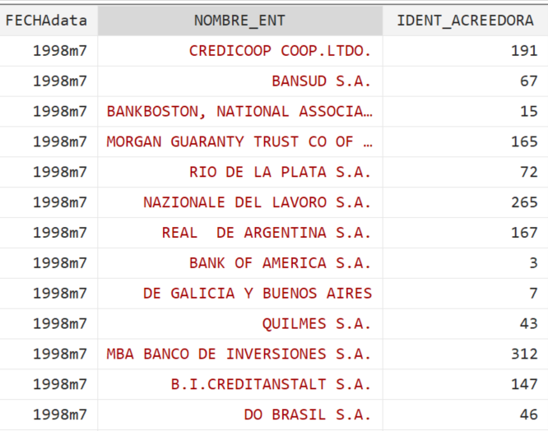
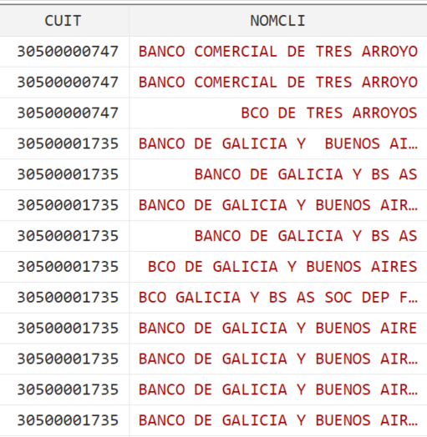
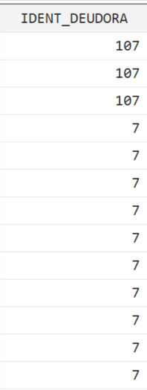
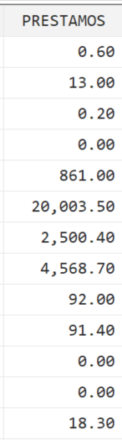
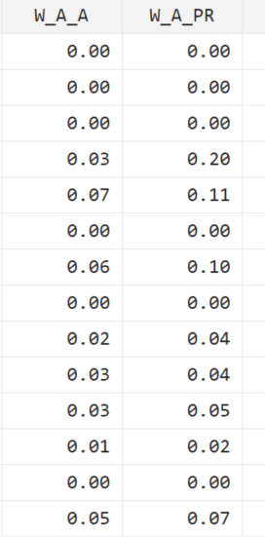
Reconstruyendo la red
$$y=ρW y+Xβ+ε$$
Registro crediticio
Central de Deudores del BCRA
Vínculos ponderados desde la perspectiva del acreedor
Préstamo ARS
ID banco acreedor
(Overnight) interbank market
CUIT deudor
ID banco deudor
Interbank loans
Balance sheet data
 | Banco A | Banco B | Banco C | TOTAL
Banco A | 0 | ? | ? | 100
Banco B | ? | 0 | ? | 120
Banco C | ? | ? | 0 | 15
TOTAL | 60 | 25 | 150 | 0
 | Banco A | Banco B | Banco C | TOTAL
Banco A | 0 | ? | ? | 100
Banco B | ? | 0 | ? | 120
Banco C | ? | ? | 0 | 15
TOTAL | 60 | 25 | 150 | 0
Notes:
Cada banco debe actualizar la informacion al menos una vez por año, mas frecuenemtenete para deudas grandes. No hay incentive a mentir ya que no puede haber una diferencia mayor a 1 en el puntaje asignado a un deudora por diferentes bancos. Ademas un banco que considera todos sus deudores con un puntaje de 1 genera sospechas en el regulador.
Banco mutual relations comprise multiple areas: syndicated loans market (many banks lending the same borrower), overnight interbank market, derivative positions (or swaps), wholesale deposit market. We only consider loans reported in the credit registry.
Interbank market data relies on trading data. In some cases the identities of the parties is unknown

Slide 8



Reconstruyendo la red
$$y=ρW y+Xβ+ε$$
Registro crediticio
Central de Deudores del BCRA
Entidades vivas a 1997q4
Sólo entidades privadas locales
Sólo entidades con observatioons completas
$$\overline{W}$$
$$\overline{X}$$
$$y$$
1997q4
1998q4
1998q4
1999q1
1999q4
2000q1
2003q4
Notes:
Excluyo bancos publicos y sucursales de bancos extranjeros como en DABOS SOSA 2004 bajo la idea de que es menos probables a quebrar.
bankFailure/output/SAR/Annual99_pastAvgW/A99_pastAvgW_creW_b97q4_s03q4.html

Slide 9
La Red
# Vínculos | # lender banks | # borrower banks | Average loan size (% lender total loans)
642 | 75 | 77 | 1.52
Notes:
Excluyo bancos publicos y sucursales de bancos extranjeros como en DABOS SOSA 2004 bajo la idea de que es menos probables a quebrar.
bankFailure/output/SAR/Annual99_pastAvgW/A99_pastAvgW_creW_b97q4_s03q4.html

Slide 10
La Red
70% de los bancos fallidos estaban directamente conectados.
Notes:
Excluyo bancos publicos y sucursales de bancos extranjeros como en DABOS SOSA 2004 bajo la idea de que es menos probables a quebrar.
bankFailure/output/SAR/Annual99_pastAvgW/A99_pastAvgW_creW_b97q4_s03q4.html

Slide 11
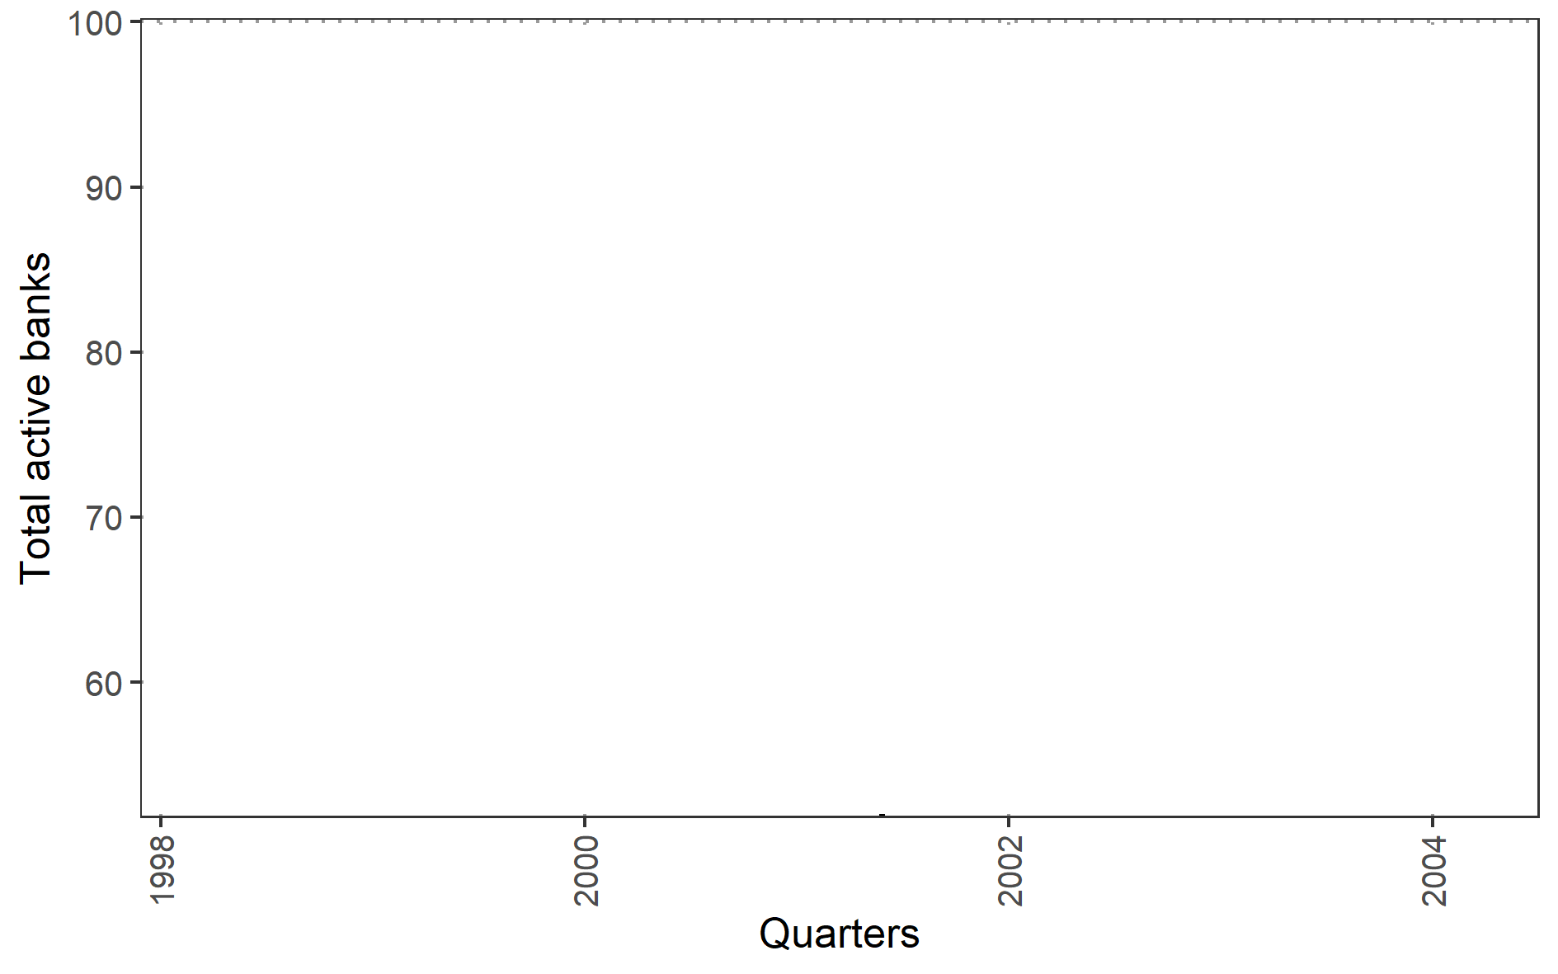
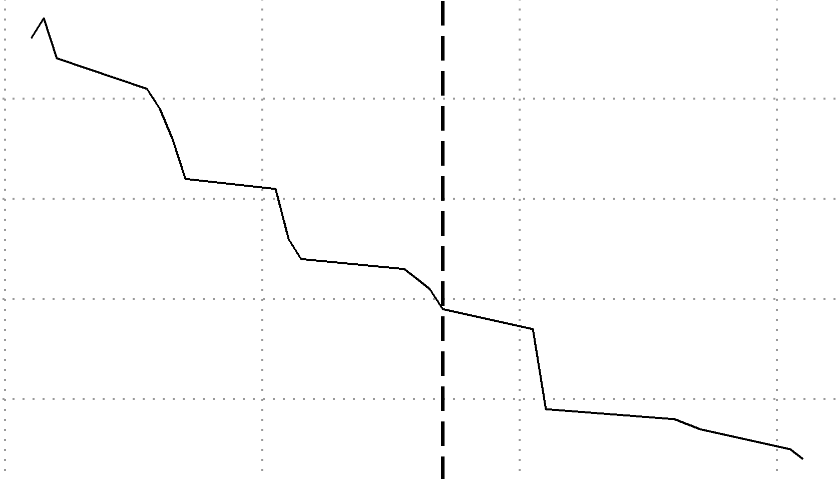

Descripción de la muestra
$$y=ρW y+Xβ+ε$$
Falla
Cualquier extinción declarada por el BCRA
Variable | Mean | SD
Assets (ARS$/USD billions) | 1,047.00 | 2,168.00
Capital (%) | 16.28 | 12
Non-performing loans (%) | 9.43 | 10
ROA (%) | 0.51 | 3
Deposits interest rate (%) | 5.36 | 3
Loans interest rate (%) | 23.64 | 10
Lending to public sector (% loans) | 3.85 | 9
USD loans (% loans) | 55.55 | 23
Loans-to-Assets (%) | 50.35 | 17
Brazil devaluation
Federal govt. collapsed
Fed tightening
New federal govt.
Currency board abandoned
New federal govt.
 | 1998
N | 105.00
SampleStart | 1998
Failure until | 2001
SurvivalRate | 0.66
5 Presidents
2001q4
Notes:
Include M&A
s98.Priv.01.onT
: 1998 annual data results/probit/failureUntil2001q4/probits-AnnualData.html
Brazil, Russian default, Fed tightening

Slide 12

Descripción de la muestra
$$y=ρW y+Xβ+ε$$
Predictores promedio de 1999
Falla ocurre entre 2000q1 y 2003q4
Predictor | Media | Coef. de variación
Tamaño
Activo en ARS $ (mill) | 1300 | 2.06
Riesgo crediticio
Cartera irregular | 13.3 | 0.78
Tasa activa | 23.9 | 0.43
Préstamos al Sector Público | 4.72 | 1.82
Préstamos en USD | 54.6 | 0.44
Préstamos a Activo | 49.8 | 0.32
Fondeo
Ratio de capital | 18.4 | 0.73
ROA | -0.33 | 10.7
Tasa pasiva | 5.49 | 0.47
N | 78
Bancos vivos a | 1997q4
Tasa de supervivencia | 0.70
Notes:
s98.Priv.01.onT
: 1998 annual data results/probit/failureUntil2001q4/probits-AnnualData.html

Slide 13



Resultados
$$y_{i}^{∗}=x_{i}^{T} β + ε_{i}$$
$$y=ρW y+Xβ+ε$$
Variable predicha: survival $1(survival)$
Predictors at 1998 (annual average)
Failure horizon is 2001q4
PREDICTOR/MODELO
(Intercepto)
Tamaño
Activo en ARS $ (mill)
Riesgo crediticio
Cartera irregular
Tasa activa
Préstamos al Sector Público
Préstamos en USD
Préstamos a Activo
Fondeo
Ratio de capital
ROA
Tasa pasiva
rho
MCO (lineal) | OLSstars
1.343 | ***
0.000 | *
-0.013 | **
0.004
-0.005
-0.006 | ***
-0.005
0.003
0.008
-0.009
Probit | probitStars
2.757 | ***
0.000
-0.038 | **
0.007
-0.014
-0.022 | ***
-0.014
0.014
0.042
-0.036
SAR (Autoregressivo espacial) | SARstars
1.742 | ***
0.000 | ***
-0.018 | ***
0.001
-0.005
-0.007 | ***
-0.006 | ***
0.004
0.001
-0.006
-0.314
78
N
F-test pvalue
Wald test spatial dependance
Likelihood ratio test spatial dependance
78
0.052
78
78
0.008
0.019
$$E\hat{\left[\frac{∂y_{i}^{∗}}{∂x_{cap,i}}\right]}=0.88±0.33$$

Slide 14










Efectos marginales promedios
$$y_{i}=Pr\left[y_{i}=1 | x_{i}\right]$$
Modelo MCO
Modelo probit
Modelo SAR
$$y_{i}^{∗}=x_{i}^{T} β + ε_{i}$$
$$y=ρW y+Xβ+ε$$
$$\hat{ρ}=−0.31$$
$$E\left[\frac{∂ y_{i}}{∂x_{i,k}}\right]=β_{k}$$
$$E\left[\frac{∂ y_{i}}{∂x_{i,k}}\right]=ϕ\left(x_{i}^{T}β\right) β_{k}$$
$$E\left[\frac{∂y_{i}}{∂x_{i,k}}\right]={\left(1−ρ\right)}^{−1} β_{k}$$
$$=0.0030$$
$$=0.0037$$
$$=0.0032$$
Notes:
El efecto 0.0037 es poco mas de la mitad del efecto de prestamos en USD. Es decir, aumentar 2% el ratio de capital aumenta la probabilidad de supervivencia en lo mismo que aumentar en 1% los prestamos en USD.

Slide 15




Efectos marginales promedios
$$y_{i}=Pr\left[y_{i}=1 | x_{i}\right]$$
Modelo SAR
Predictor | Efecto marginal x100
 | Directo | Indirecto | Total
$$y=ρW y+Xβ+ε$$
$$\hat{ρ}=−0.31$$
Ratio de capital
0.43 | -0.10 | 0.32
$$E\left[\frac{∂y_{i}}{∂x_{i,k}}\right]={\left(1−ρ\right)}^{−1} β_{k}$$
$$=0.0032$$

Slide 16
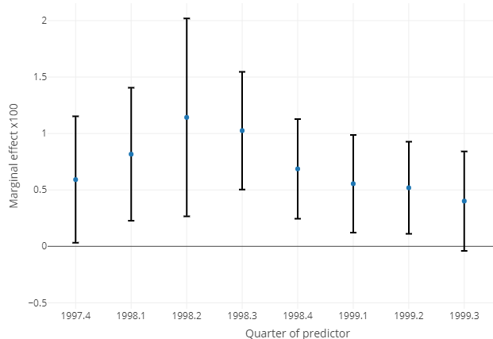






Results
 | Survival probability
 | Coefficients x 100
Capital ratio | 2.36 | **
Non-perfoming loans ratio | -3.10
Deposits interest rate (%) | 8.86 | *
Loans interest rate (%) | 1.33
ROA (%) | 8.82
Lending to public sector ratio | 9.48 | **
USD loans percentage (%) | 0.02
Loans-to-Assets ratio | 0.20
N | 105
AIC | 121
logLik (df=10) | -50.55
Probit case
Predictors at quarterly frequency since 1997q4 to 1999q3
Failure horizon is 2001q4
Predictors at 1998 (annual average)
Failure horizon is 2001q4
$$y_{i,t}^{∗}=x_{i,t}^{T} β + u_{i,t}^{∗}$$
$$u_{i,t }^{∗}∼𝒩\left(0,1\right)$$
$$\sum_{i=1}^{N}{}$$
$$E\hat{\left[\frac{∂y_{i}^{∗}}{∂x_{k,i}}\right]}=$$
$$φ\left( x_{i}^{T} \hat{β}\right)$$
$$\hat{β_{k}}$$
Marginal effect capital (at 90%)
$$E\hat{\left[\frac{∂y_{i}^{∗}}{∂x_{cap,i}}\right]}=0.88±0.33$$
Notes:
Bank mutual relations comprise multiple areas: syndicated loans market (many banks lending the same borrower), overnight interbank market, derivative positions (or swaps), wholesale deposit market. We only consider loans reported in the credit registry.
Interbank market data relies on trading data. In some cases the identities of the parties is unknown

